Slide 1


Computer Networks
Lectures (Chapter5)
Network Layer: Control Plane
Subhan Ullah, PhD
subhan.ullah@nu.edu.pk
BS(Computer Science) Fall-2024

Slide 2
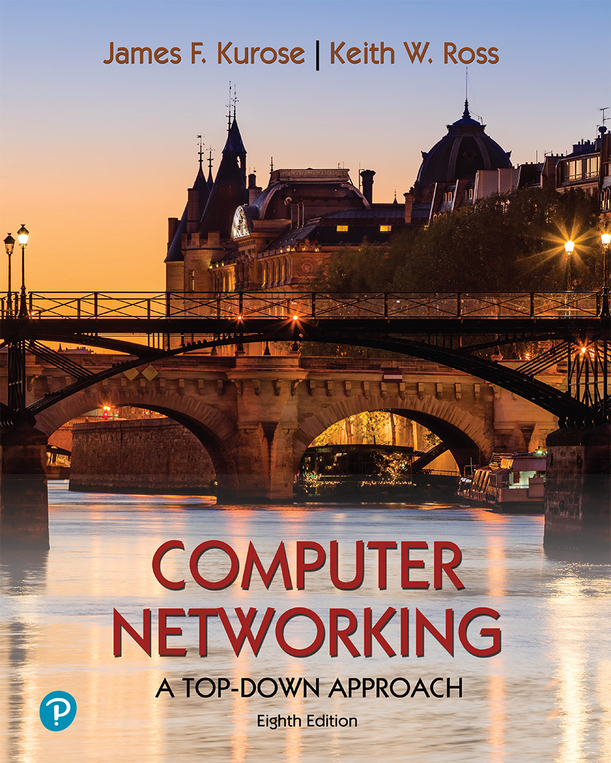
Chapter 5 Network Layer:
Control Plane
A note on the use of these PowerPoint slides:
We’re making these slides freely available to all (faculty, students, readers). They’re in PowerPoint form so you see the animations; and can add, modify, and delete slides (including this one) and slide content to suit your needs. They obviously represent a lot of work on our part. In return for use, we only ask the following:
If you use these slides (e.g., in a class) that you mention their source (after all, we’d like people to use our book!)
If you post any slides on a www site, that you note that they are adapted from (or perhaps identical to) our slides, and note our copyright of this material.
For a revision history, see the slide note for this page.
Thanks and enjoy! JFK/KWR
All material copyright 1996-2023
J.F Kurose and K.W. Ross, All Rights Reserved
Computer Networking: A Top-Down Approach 8th edition Jim Kurose, Keith Ross Pearson, 2020
Notes:
Version History
8.0 (May 2020)
All slides reformatted for 16:9 aspect ratio
All slides updated to 8th edition material
Use of Calibri font, rather that Gill Sans MT
Add LOTS more animation throughout
lighter header font
Re-do of network management slides; redo of Bellman-Ford slides
8.2 (changes over 8.0)
improved animations of Dijkstra’s algorithm and Bellman Ford
various improvements to BGP
SDN: added Google Orion (2021 Google network SDN control plane)

Slide 3
Network layer control plane: our goals
understand principles behind network control plane:
traditional routing algorithms
SDN controllers
network management, configuration
instantiation, implementation in the Internet:
OSPF, BGP
OpenFlow, ODL and ONOS controllers
Internet Control Message Protocol: ICMP
SNMP, YANG/NETCONF

Slide 4

Network layer: “control plane” roadmap
introduction
routing protocols
link state
distance vector
intra-ISP routing: OSPF
routing among ISPs: BGP
SDN control plane
Internet Control Message Protocol
network management, configuration
SNMP
NETCONF/YANG

Slide 5
Distance vector algorithm
Based on Bellman-Ford (BF) equation (dynamic programming):
Bellman-Ford equation
Let D_{x}(y): cost of least-cost path from x to y.
Then:
D_{x}(y) = min_{v} { c_{x,v} + D_{v}(y) }
v’s estimated least-cost-path cost to y
min taken over all neighbors v of x
direct cost of link from x to v

Slide 6
Bellman-Ford Example
Suppose that u’s neighboring nodes, x,v,w, know that for destination z:
D_{v}(z) = 5
D_{w}(z) = 3
Bellman-Ford equation says:
5
D_{u}(z) = min { c_{u,v} + D_{v}(z),
c_{u,x} + D_{x}(z),
c_{u,w} + D_{w}(z) }
v
3
w
2
5
u
2
1
z
3
= min {2 + 5,
1 + 3,
5 + 3} = 4
1
2
x
y
1
D_{x}(z) = 3
node achieving minimum (x) is next hop on estimated least-cost path to destination (z)

Slide 7
Distance vector algorithm
key idea:
from time-to-time, each node sends its own distance vector estimate to neighbors
when x receives new DV estimate from any neighbor, it updates its own DV using B-F equation:
D_{x}(y) ← min_{v}{c_{x,v} + D_{v}(y)} for each node y ∊ N
under minor, natural conditions, the estimate D_{x}(y) converge to the actual least cost d_{x}(y)

Slide 8
Distance vector algorithm:
each node:
iterative, asynchronous: each local iteration caused by:
local link cost change
DV update message from neighbor
wait for (change in local link cost or msg from neighbor)
recompute DV estimates using DV received from neighbor
distributed, self-stopping: each node notifies neighbors only when its DV changes
neighbors then notify their neighbors – only if necessary
no notification received, no actions taken!
if DV to any destination has changed, notify neighbors

Slide 9
Distance vector algorithm:
Within a specific routing table, each row is a distance vector
node x’s initial routing table.
node x
table
cost to
x y z
x
0 2 7
D_{x} = [D_{x}(x), D_{x}(y), D_{x}(z)]
y
∞
∞
∞
from
z
∞
∞
∞
received distance vectors, at initialization node x has not received anything from node y or z,
node y
table
cost to
x y z
y
2
1
x
∞
∞
z
∞
2 0 1
x
from
y
7
z
∞
∞
∞
node z
table
cost to
x y z
x
∞ ∞ ∞
from
y
∞
∞
∞
z
7
1
0
time

Slide 10
Distance vector algorithm:
D_{x}(y) = min{c(x,y) + D_{y}(y), c(x,z) + D_{z}(y)} = min{2+0 , 7+1} = 2
D_{x}(z) = min{c(x,y) + D_{y}(z),
c(x,z) + D_{z}(z)}
= min{2+1 , 7+0} = 3
node x
table
cost to
cost to
x y z
x y z
x
0 2 7
x
0
2
3
y
y
2 0 1
from
∞
∞
∞
from
After receiving the updates, each node recomputes its own distance vector.
z
∞
∞
∞
z
7 1 0
node y
table
cost to
After initialization, each node sends its distance vector to each of its two neighbors.
x y z
x y z
y
2
1
x
∞
∞
x
0 2 7
z
∞
2 0 1
x
from
y
y
2 0 1
7
from
z
∞
∞
∞
z
7 1 0
D_{x}(node) ← min_{nbr}{c(x,nbr) + D_{nbr}(node)} for each node∊N
node z
table
cost to
cost to
x y z
x y z
estimated cost from neighbor nbr to node
x
∞ ∞ ∞
x
0 2 7
cost to neighbor nbr
y
from
y
∞
∞
from
2 0 1
∞
z
z
3 1 0
min taken over all neighbors nbr of x
7
1
0

Slide 11
Distance vector algorithm:
node x
table
cost to
cost to
cost to
x y z
x y z
x y z
x
0 2 7
x
0
2
3
x
0 2 3
y
y
2 0 1
from
∞
∞
∞
from
y
2 0 1
z
z
from
∞
∞
∞
7 1 0
z
3 1 0
only nodes x and z send updates: node y’s distance vector didn’t change so node y doesn’t send an update.
At this point, since no update messages are sent, no further routing table calculations will occur and the algorithm will enter a quiescent state; that is, all nodes will be performing the wait
node y
table
cost to
cost to
cost to
x y z
x y z
x y z
y
2
1
x
∞
∞
x
0 2 7
∞
2 0 1
x
0 2 3
x
z
y
y
After the nodes recompute their distance vectors, they again send their updated distance vectors to their neighbors (if there has been a change).
from
from
2 0 1
y
2 0 1
7
z
z
from
∞
∞
∞
7 1 0
z
3 1 0
node z
table
cost to
cost to
cost to
x y z
x y z
x y z
x
∞ ∞ ∞
x
0 2 7
x
0 2 3
y
y
2 0 1
from
y
∞
∞
from
2 0 1
from
∞
z
z
3 1 0
z
3 1 0
7
1
0
time
time

Slide 12
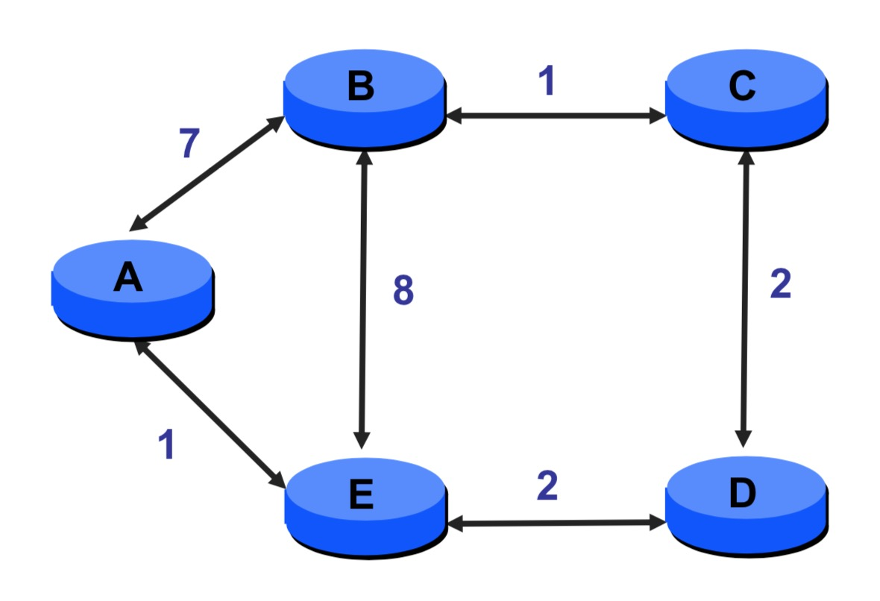
Another Example

Slide 13
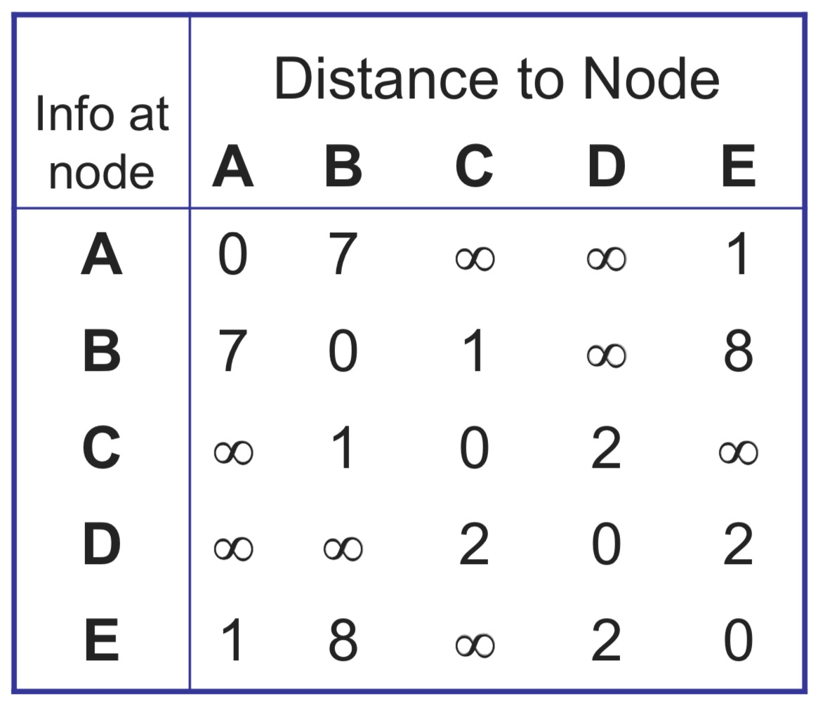
Initial tables
4-13

Slide 15
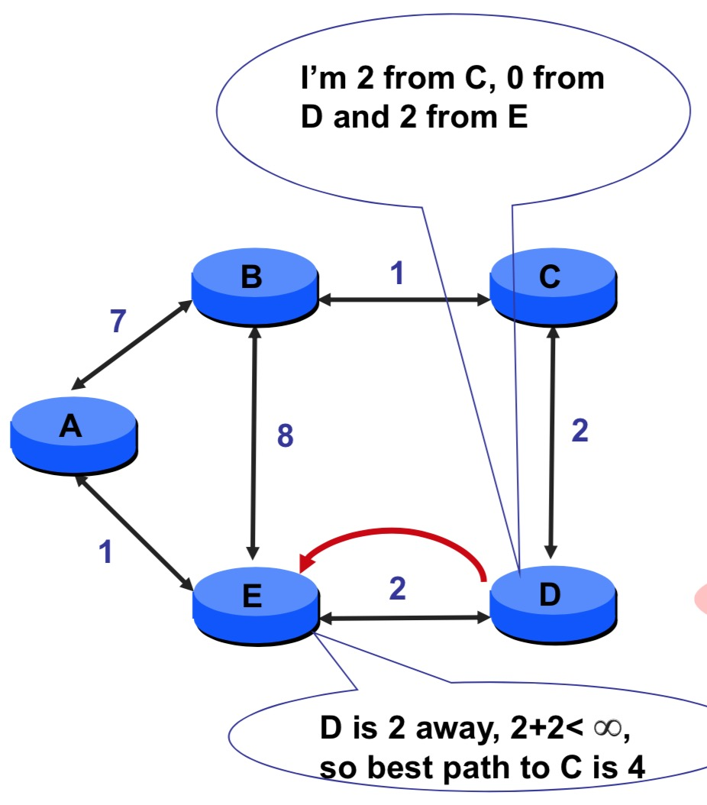
D sends vector to E

Slide 16
D sends vector to E
D
E

Slide 17
D sends vector to E
D
E
4

Slide 18
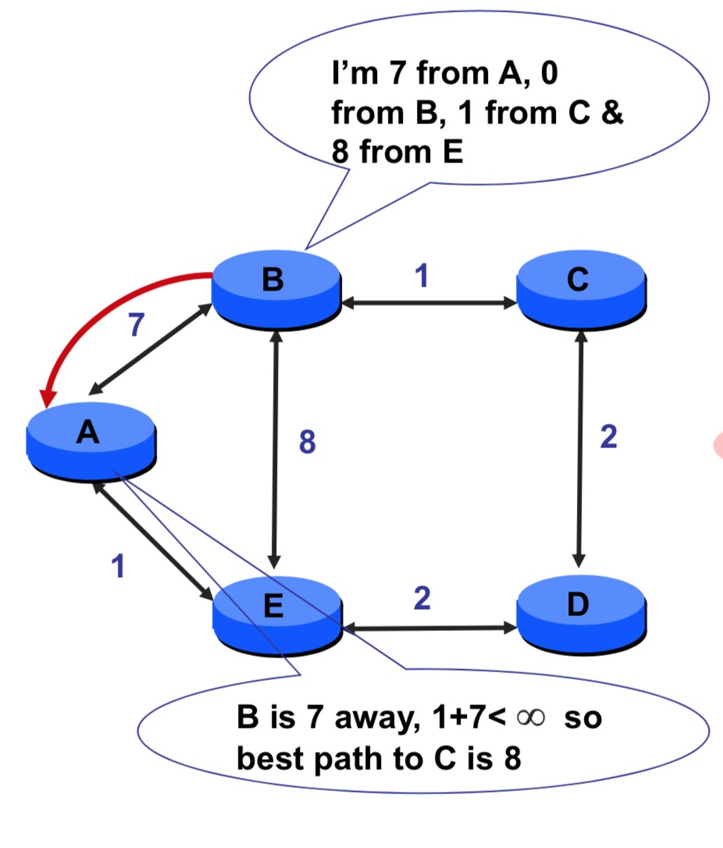
B sends vector to A

Slide 19
B sends vector to A
A
B

Slide 20
B sends vector to A
A
8
B

Slide 21
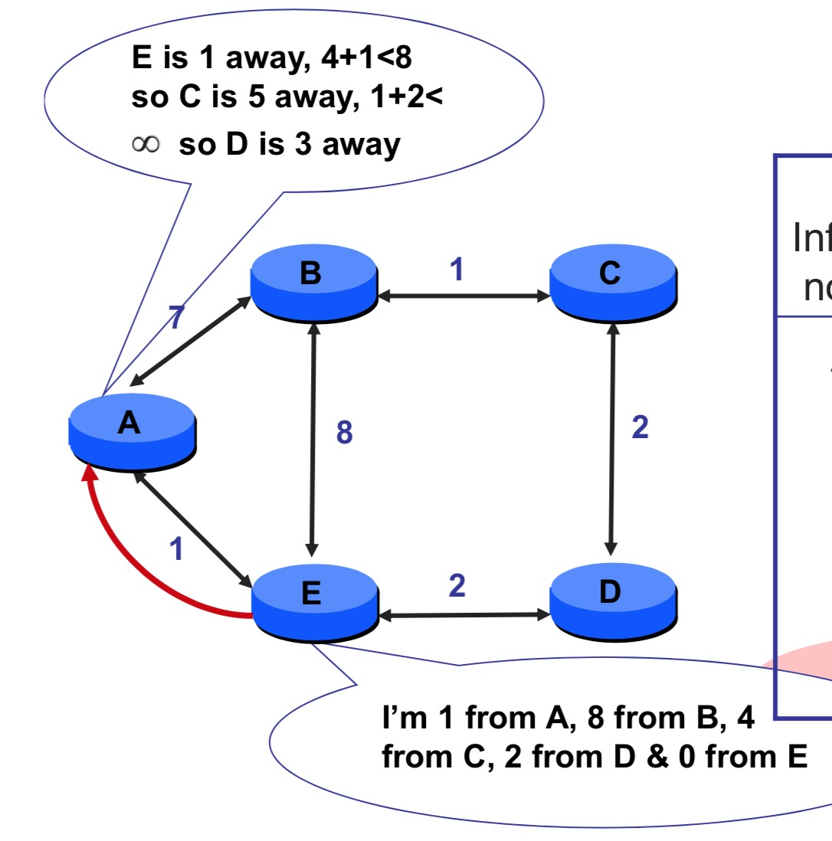
E sends vector to A

Slide 22
When does it end?
The process continues until convergance
What is convergance?

Slide 23
Distance vector: example
DV in a: D_{a}(a)=0
D_{a}(b) = 8
D_{a}(c) = ∞
D_{a}(d) = 1
D_{a}(e) = ∞
D_{a}(f) = ∞
D_{a}(g) = ∞
D_{a}(h) = ∞
D_{a}(i) = ∞
a
b
c
8
1
t=0
1
1
All nodes have distance estimates to nearest neighbors (only)
A few asymmetries:
missing link
larger cost
d
e
f
1
1
All nodes send their local distance vector to their neighbors
1
1
1
g
h
i
1
1

Slide 24
Distance vector example: iteration
a
b
c
8
1
t=1
1
1
All nodes:
receive distance vectors from neighbors
compute their new local distance vector
send their new local distance vector to neighbors
d
e
f
1
1
1
1
1
g
h
i
1
1

Slide 25
Distance vector example: iteration
a
compute
compute
compute
b
c
8
1
t=1
1
1
All nodes:
receive distance vectors from neighbors
compute their new local distance vector
send their new local distance vector to neighbors
d
compute
e
f
compute
compute
1
1
1
1
1
g
h
i
compute
compute
1
compute
1

Slide 26
Distance vector example: iteration
a
b
c
8
1
t=1
1
1
All nodes:
receive distance vectors from neighbors
compute their new local distance vector
send their new local distance vector to neighbors
d
e
f
1
1
1
1
1
g
h
i
1
1

Slide 27
Distance vector example: iteration
a
b
c
8
1
t=2
1
1
All nodes:
receive distance vectors from neighbors
compute their new local distance vector
send their new local distance vector to neighbors
d
e
f
1
1
1
1
1
g
h
i
1
1

Slide 28
Distance vector example: iteration
compute
compute
compute
a
b
c
2
1
t=2
1
1
All nodes:
receive distance vectors from neighbors
compute their new local distance vector
send their new local distance vector to neighbors
d
compute
compute
compute
e
f
1
1
1
1
1
g
compute
compute
compute
h
i
8
1

Slide 29
Distance vector example: iteration
a
b
c
8
1
t=2
1
1
All nodes:
receive distance vectors from neighbors
compute their new local distance vector
send their new local distance vector to neighbors
d
e
f
1
1
1
1
1
g
h
i
1
1

Slide 30
Distance vector example: iteration
…. and so on
Let’s next take a look at the iterative computations at nodes

Slide 31
Distance vector example: computation
DV in b:
DV in c:
D_{c}(a) = ∞
D_{c}(b) = 1
D_{c}(c) = 0
D_{c}(d) = ∞
D_{c}(e) = ∞
D_{c}(f) = ∞
D_{c}(g) = ∞
D_{c}(h) = ∞
D_{c}(i) = ∞
D_{b}(a) = 8
D_{b}(c) = 1
D_{b}(d) = ∞
D_{b}(e) = 1
D_{b}(f) = ∞
D_{b}(g) = ∞
D_{b}(h) = ∞
D_{b}(i) = ∞
DV in a: D_{a}(a)=0
D_{a}(b) = 8
D_{a}(c) = ∞
D_{a}(d) = 1
D_{a}(e) = ∞
D_{a}(f) = ∞
D_{a}(g) = ∞
D_{a}(h) = ∞
D_{a}(i) = ∞
a
b
c
8
1
t=1
1
1
b receives DVs from a, c, e
DV in e:
D_{e}(a) = ∞
D_{e}(b) = 1
D_{e}(c) = ∞
D_{e}(d) = 1
D_{e}(e) = 0
D_{e}(f) = 1
D_{e}(g) = ∞
D_{e}(h) = 1
D_{e}(i) = ∞
d
e
f
1
1
1
1
1
g
h
i
1
1

Slide 32
Distance vector example: computation
DV in b:
DV in c:
D_{c}(a) = ∞
D_{c}(b) = 1
D_{c}(c) = 0
D_{c}(d) = ∞
D_{c}(e) = ∞
D_{c}(f) = ∞
D_{c}(g) = ∞
D_{c}(h) = ∞
D_{c}(i) = ∞
D_{b}(a) = 8
D_{b}(c) = 1
D_{b}(d) = ∞
D_{b}(e) = 1
D_{b}(f) = ∞
D_{b}(g) = ∞
D_{b}(h) = ∞
D_{b}(i) = ∞
DV in a: D_{a}(a)=0
D_{a}(b) = 8
D_{a}(c) = ∞
D_{a}(d) = 1
D_{a}(e) = ∞
D_{a}(f) = ∞
D_{a}(g) = ∞
D_{a}(h) = ∞
D_{a}(i) = ∞
a
b
c
b
8
compute
1
t=1
1
1
b receives DVs from a, c, e, computes:
DV in e:
D_{e}(a) = ∞
D_{e}(b) = 1
D_{e}(c) = ∞
D_{e}(d) = 1
D_{e}(e) = 0
D_{e}(f) = 1
D_{e}(g) = ∞
D_{e}(h) = 1
D_{e}(i) = ∞
e
d
e
f
1
1
D_{b}(a) = min{c_{b,a}+D_{a}(a), c_{b,c} +D_{c}(a), c_{b,e}+D_{e}(a)} = min{8,∞,∞} = 8
D_{b}(c) = min{c_{b,a}+D_{a}(c), c_{b,c} +D_{c}(c), c _{b,e} +D_{e}(c)} = min{∞,1,∞} = 1
D_{b}(d) = min{c_{b,a}+D_{a}(d), c_{b,c} +D_{c}(d), c _{b,e} +D_{e}(d)} = min{9,2,∞} = 2
1
1
1
D_{b}(e) = min{c_{b,a}+D_{a}(e), c_{b,c} +D_{c}(e), c _{b,e} +D_{e}(e)} = min{∞,∞,1} = 1
DV in b:
D_{b}(f) = min{c_{b,a}+D_{a}(f), c_{b,c} +D_{c}(f), c _{b,e} +D_{e}(f)} = min{∞,∞,2} = 2
D_{b}(g) = min{c_{b,a}+D_{a}(g), c_{b,c} +D_{c}(g), c _{b,e}+D_{e}(g)} = min{∞, ∞, ∞} = ∞
D_{b}(a) = 8
D_{b}(c) = 1
D_{b}(d) = 2
D_{b}(e) = 1
D_{b}(f) =2
D_{b}(g) = ∞
D_{b}(h) = 2
D_{b}(i) = ∞
g
h
1
i
1
D_{b}(h) = min{c_{b,a}+D_{a}(h), c_{b,c} +D_{c}(h), c _{b,e}+D_{e}(h)} = min{∞, ∞, 2} = 2
D_{b}(i) = min{c_{b,a}+D_{a}(i), c_{b,c} +D_{c}(i), c _{b,e}+D_{e}(i)} = min{∞, ∞, ∞} = ∞

Slide 33
Distance vector example: computation
DV in b:
DV in c:
D_{c}(a) = ∞
D_{c}(b) = 1
D_{c}(c) = 0
D_{c}(d) = ∞
D_{c}(e) = ∞
D_{c}(f) = ∞
D_{c}(g) = ∞
D_{c}(h) = ∞
D_{c}(i) = ∞
D_{b}(a) = 8
D_{b}(c) = 1
D_{b}(d) = ∞
D_{b}(e) = 1
D_{b}(f) = ∞
D_{b}(g) = ∞
D_{b}(h) = ∞
D_{b}(i) = ∞
DV in a: D_{a}(a)=0
D_{a}(b) = 8
D_{a}(c) = ∞
D_{a}(d) = 1
D_{a}(e) = ∞
D_{a}(f) = ∞
D_{a}(g) = ∞
D_{a}(h) = ∞
D_{a}(i) = ∞
a
b
c
8
1
t=1
1
1
c receives DVs from b
DV in e:
D_{e}(a) = ∞
D_{e}(b) = 1
D_{e}(c) = ∞
D_{e}(d) = 1
D_{e}(e) = 0
D_{e}(f) = 1
D_{e}(g) = ∞
D_{e}(h) = 1
D_{e}(i) = ∞
d
e
f
1
1
1
1
1
g
h
i
1
1

Slide 34
Distance vector example: computation
DV in b:
DV in c:
D_{c}(a) = ∞
D_{c}(b) = 1
D_{c}(c) = 0
D_{c}(d) = ∞
D_{c}(e) = ∞
D_{c}(f) = ∞
D_{c}(g) = ∞
D_{c}(h) = ∞
D_{c}(i) = ∞
D_{b}(a) = 8
D_{b}(c) = 1
D_{b}(d) = ∞
D_{b}(e) = 1
D_{b}(f) = ∞
D_{b}(g) = ∞
D_{b}(h) = ∞
D_{b}(i) = ∞
a
b
c
1
compute
8
t=1
1
1
c receives DVs from b computes:
d
e
f
D_{c}(a) = min{c_{c,b}+D_{b}(a}} = 1 + 8 = 9
DV in c:
D_{c}(a) = 9
D_{c}(b) = 1
D_{c}(c) = 0
D_{c}(d) = 2
D_{c}(e) = ∞
D_{c}(f) = ∞
D_{c}(g) = ∞
D_{c}(h) = ∞
D_{c}(i) = ∞
D_{c}(b) = min{c_{c,b}+D_{b}(b)} = 1 + 0 = 1
D_{c}(d) = min{c_{c,b}+D_{b}(d)} = 1+ ∞ = ∞
D_{c}(e) = min{c_{c,b}+D_{b}(e)} = 1 + 1 = 2
D_{c}(f) = min{c_{c,b}+D_{b}(f)} = 1+ ∞ = ∞
D_{c}(g) = min{c_{c,b}+D_{b}(g)} = 1+ ∞ = ∞
* Check out the online interactive exercises for more examples: http://gaia.cs.umass.edu/kurose_ross/interactive/
g
h
i
D_{c}(h) = min{c_{bc,b}+D_{b}(h)} = 1+ ∞ = ∞
D_{c}(i) = min{c_{c,b}+D_{b}(i)} = 1+ ∞ = ∞

Slide 35
Distance vector example: computation
DV in b:
D_{b}(a) = 8
D_{b}(c) = 1
D_{b}(d) = ∞
D_{b}(e) = 1
D_{b}(f) = ∞
D_{b}(g) = ∞
D_{b}(h) = ∞
D_{b}(i) = ∞
DV in e:
D_{e}(a) = ∞
D_{e}(b) = 1
D_{e}(c) = ∞
D_{e}(d) = 1
D_{e}(e) = 0
D_{e}(f) = 1
D_{e}(g) = ∞
D_{e}(h) = 1
D_{e}(i) = ∞
DV in d:
D_{c}(a) = 1
D_{c}(b) = ∞
D_{c}(c) = ∞
D_{c}(d) = 0
D_{c}(e) = 1
D_{c}(f) = ∞ D_{c}(g) = 1
D_{c}(h) = ∞
D_{c}(i) = ∞
a
b
c
8
1
t=1
Q: what is new DV computed in e at t=1?
1
1
e receives DVs from b, d, f, h
d
compute
f
DV in f:
D_{c}(a) = ∞
D_{c}(b) = ∞
D_{c}(c) = ∞
D_{c}(d) = ∞
D_{c}(e) = 1
D_{c}(f) = 0
D_{c}(g) = ∞
D_{c}(h) = ∞
D_{c}(i) = 1
e
DV in h:
D_{c}(a) = ∞
D_{c}(b) = ∞
D_{c}(c) = ∞
D_{c}(d) = ∞
D_{c}(e) = 1
D_{c}(f) = ∞
D_{c}(g) = 1
D_{c}(h) = 0
D_{c}(i) = 1
1
1
1
1
1
g
h
i
1
1

Slide 36
Distance vector: state information diffusion
Iterative communication, computation steps diffuses information through network:
t=0
c’s state at t=0 is at c only
a
b
c
8
1
c’s state at t=0 has propagated to b, and may influence distance vector computations up to 1 hop away, i.e., at b
t=1
1
1
t=1
t=2
c’s state at t=0 may now influence distance vector computations up to 2 hops away, i.e., at b and now at a, e as well
t=2
d
e
f
1
1
t=3
c’s state at t=0 may influence distance vector computations up to 3 hops away, i.e., at d, f, h
1
1
1
t=3
c’s state at t=0 may influence distance vector computations up to 4 hops away, i.e., at g, i
t=4
g
h
i
1
1
t=4

Slide 37
Distance vector: link cost changes
link cost changes:
node detects local link cost change
updates routing info, recalculates local DV
if DV changes, notify neighbors
1
y
4
1
x
z
50
t₀ : y detects link-cost change, updates its DV, informs its neighbors.
“good news
travels fast”
t₁ : z receives update from y, updates its DV, computes new least cost to x , sends its neighbors its DV.
t₂ : y receives z’s update, updates its DV. y’s least costs do not change, so y does not send a message to z.

Slide 38
Distance vector: link cost changes
link cost changes:
node detects local link cost change
“bad news travels slow” – count-to-infinity problem:
60
y
4
1
x
z
50
y sees direct link to x has new cost 60, but z has said it has a path at cost of 5. So y computes “my new cost to x will be 6, via z); notifies z of new cost of 6 to x.
z learns that path to x via y has new cost 6, so z computes “my new cost to x will be 7 via y), notifies y of new cost of 7 to x.
y learns that path to x via z has new cost 7, so y computes “my new cost to x will be 8 via y), notifies z of new cost of 8 to x.
z learns that path to x via y has new cost 8, so z computes “my new cost to x will be 9 via y), notifies y of new cost of 9 to x.
…
see text for solutions. Distributed algorithms are tricky!

Slide 39
Comparison of LS and DV algorithms
message complexity
LS: n routers, O(n²) messages sent
DV: exchange between neighbors; convergence time varies
robustness: what happens if router malfunctions, or is compromised?
LS:
router can advertise incorrect link cost
each router computes only its own table
DV:
DV router can advertise incorrect path cost (“I have a really low-cost path to everywhere”): black-holing
each router’s DV is used by others: error propagate thru network
speed of convergence
LS: O(n²) algorithm, O(n²) messages
may have oscillations
DV: convergence time varies
may have routing loops
count-to-infinity problem

Slide 40
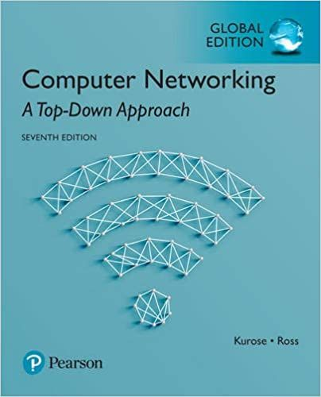
Thank You All
☺
?
A note on the origin of these ppt slides:
All material copyright 1996-2020 J.F Kurose and K.W. Ross, All Rights Reserved
These slides are freely provided by the book authors and it represents a lot of work on their part. We would like to thank J.F Kurose and K.W. Ross.
Transport Layer: 3-150
Notes:
Section F and G ended

